Slide 1
lntroduction to XML
An universal data format

Slide 2
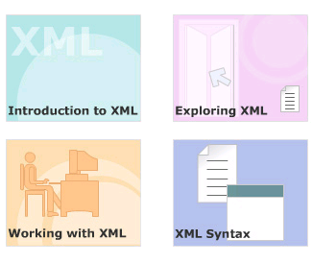
Module Introduction
Welcome to the module, Introduction to XML.
The module describes drawbacks of earlier mark up languages that led to the development of XML.
The module also explains the structure and lifecycle of the XML document.
This module covers more on the XML syntax and the various parts of the XML document.
In this module, you will learn about:
  Introduction to XML
  Exploring XML
  Working with XML
  XML Syntax

Slide 3
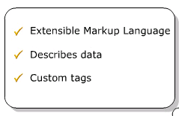
Features of XML
XML stands for Extensible Markup Language
XML is a markup language much like HTML
XML was designed to describe data
XML tags are not predefined. You must define your own tags

Slide 4
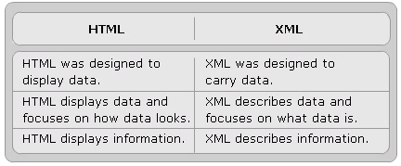
The Difference Between XML and HTML
XML is not a replacement for HTML.
  XML was created to structure, store, and transport information.
XML and HTML were designed with different goals:

Slide 5
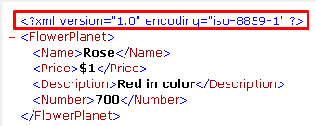
XML Markup
Defines the physical and logical layout of the document.
Markup helps program to find distinguish a piece of text from any other piece
Divides a document into separate information containers called elements.
A XML document consists of
  XML declaration
  One outermost element, root element
  Root element contains all the other elements
XML can be used to create other languages like WAP and WML.

Slide 6
Benefits of XML or How Can XML be Used?
Web development, to simplify data storage and sharing.
Separates Data from HTML
Simplifies Data Sharing
Simplifies Data Transport
Simplifies Platform Changes
Makes Your Data More Available
Used to Create New Internet Languages

Slide 7
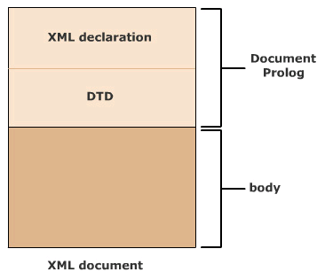
Logical Structure
Gives information about the elements and the order in which they are to be included in the document.
It shows how a document is constructed rather than what it contains.

Slide 8
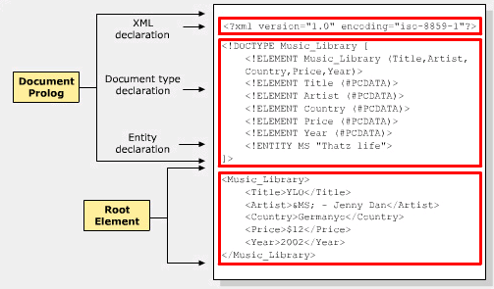
XML Document Structure
XML documents are commonly stored in text files with extension “.xml”
The two sections of an XML document are:
  Document Prolog
  Root Element

Slide 9
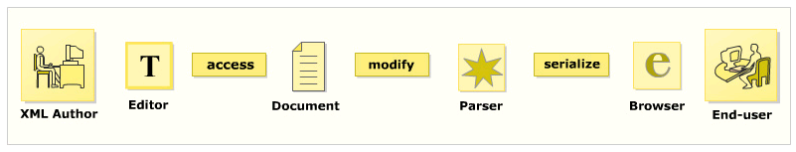
Life cycle of an XML document

Slide 10
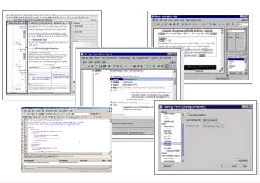
XML Editors
The main functions that editors provide are as follows:
  Add opening and closing tags to the code
  Check for validity of XML
  Verify XML against a DTD/Schema
  Perform series of transforms over a document
  Color the XML syntax
  Display the line numbers
  Present the content and hide the code
  Complete the word
The popularly used editors are:
  XMLwriter
  XML Spy
  XML Pro
  XMLmind
  XMetal

Slide 11
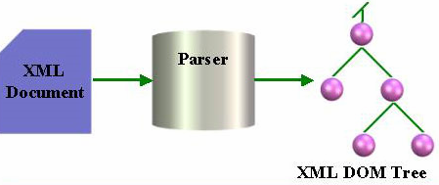
XML Parsers
Parsing XML means “read and manipulate XML data”
Use XML parser to parse XML
  Read XML document
  Verifie its well-formedness
  Converts XML document into a tree of elements or a data structure

Slide 12
Creating an XML document
An XML document has three main components:
  Tags(markup) and text(content)
  DTD or Schema
  Formatting or display specifications
The steps to build an XML document are as follows:
  Create an XML document in an editor.
  Save the XML document.
  Load XML document in a browser.

Slide 13
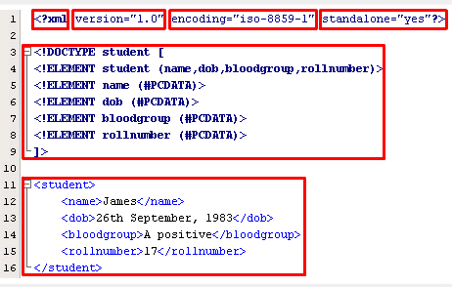
Exploring the XML document
XML Version Declaration
Document Type Definition (DTD)
Document instance
  The content, defined by the mark up

Slide 14
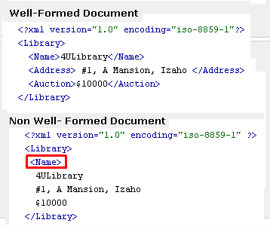
Well-formed XML document
Minimum of one element is required,
XML tags are case sensitive.
Every start tag should end with end tag.
XML tags should be nested properly.
XML tags should be valid.
Length of markup names
XML attributes should be valid.
XML documents should be verified

Slide 15
#4- XML Syntax
State and describe the use of comments and processing instructions in XML.
Classify character data that is written between tags.
Describe entities, DOCTYPE declarations and attributes.

Slide 16
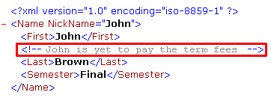
Comments
Give information about the code
Can appear in the document prolog, DTD or in the textual content.
Not appear inside the tags or attribute values.
Syntax:
  <! -- <comments> -->

Slide 17
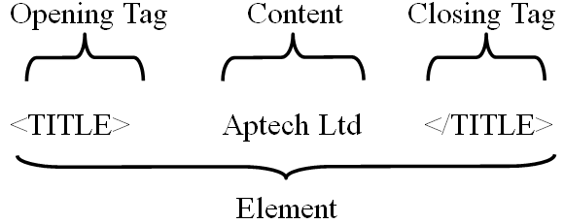
XML Elements
Is everything from (including) the element's start tag to (including) the element's end tag.
Can contain other elements, simple text or a mixture of both. Elements can also have attributes.
XML Naming Rules
  Can contain letters, numbers, and other characters
  Must not start with a number or punctuation character
  Cannot contain spaces

Slide 18
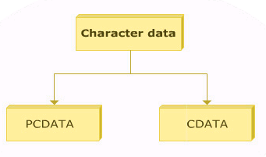
Classification of character data
An XML document is divided into markup and character data.
Character data describes the document's actual content with the white space.
The text in character data is not processed by the parser and thus not treated as a regular text.
The character data can be classified into:
  CDATA
  PCDATA

Slide 19

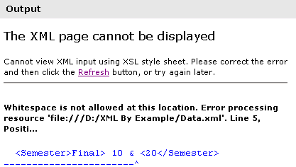
PCDATA (parsed character data)
The data that is parsed by the parser
Specifies that the element has parsed character data.
Used in the element declaration.
Escape character like "<" when used in the XML document will make the parser interpret it as a new element.

Slide 20

CDATA
The text inside a CDATA section is not parsed by the XML parser.
  A text is considered in a CDATA section if it contains '<' or '<&>' characters.
The syntax for CDATA "<![CDATA[……]]>”
The CDATA sections:
  Cannot be nested.
  Does not accept line breaks or spaces inside the "]]>" string.

Slide 21
Entity Categories
General Entity
  Used within the document content.
  Refer to the content of a named entity.
  References to these entities: ‘&<entity_name>;’
Parameter Entity
  Used only in the DTD.
  Declared in DTD.
  References to these entities: ‘%<entity_name>;’

Slide 22
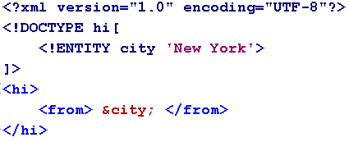
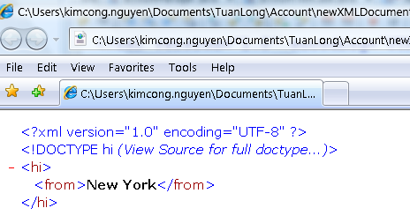
Entities
Construct that are referenced in the document
Every entity consists: name - value.
As the XML document is parsed, it checks for entity references.
For every entity reference, the parser checks the memory to replace the entity reference with a text or markup.
Syntax for an entity reference:
  ‘&<entity name>;’.
All the entities must be declared before they are used in the document.
  An entity can be declared either in a document prolog or in a DTD.

Slide 23
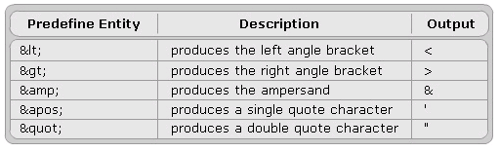
Pre­defined entities

Slide 24
DOCTYPE declarations
Defines the elements to be used in the document.
To indicate what DTD the document adheres to.
It can be declared either:
  In the XML document (internal)
  Referenced to the external document (external)

Slide 25
Example of DOCTYPE declarations - Internal

Slide 26

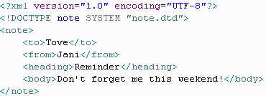
Example of DOCTYPE declarations - External
DTD file (note.dtd)
XML file

Slide 27
That’s about all for today !
Introduction to XML
Exploring XML
Working with XML
XML Syntax
Thank you all for your attention and patient !

